Slide 1
Capstone project E-Learning website
Unicorn Team

Slide 2
Project team

Slide 3
Table content
1. Background
2. Ideal
3. Objective
4. Project Management Plan
5. Software Requirement Specification
6. System Analysis and Design
7. Test Plan and Test Report
8. Summary
9. Q&A

Slide 4
Background

Slide 5
Idea

Slide 6
objective

Slide 7
Project Management Plan
1. Software process model
2. Project plan
3. Risk management
4. Quality Plan

Slide 8
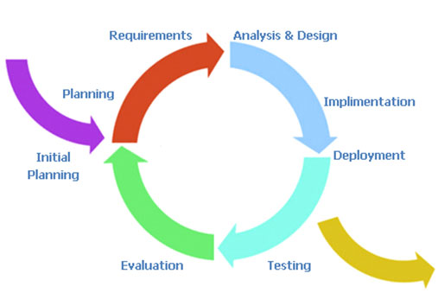
Project Management Plan Software process model
Iterative Model

Slide 9
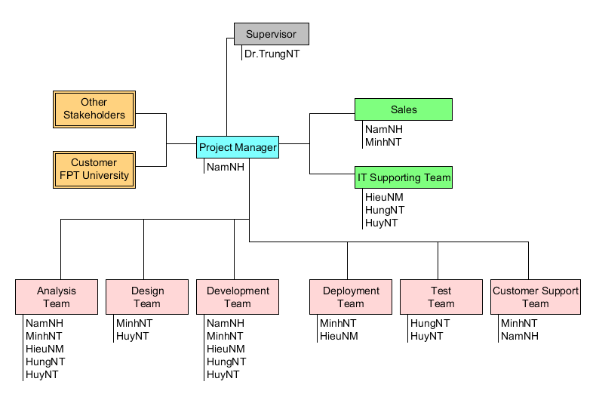
Project Management Plan Project Plan
Role and Responsible

Slide 10
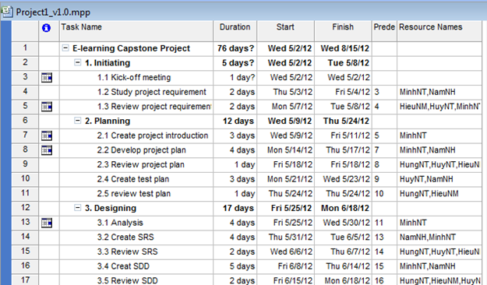
Project Management Plan Project Plan
Overall Plan

Slide 11
Project Management Plan Risk management

Slide 12
Project Management Plan Quality plan

Slide 13
Success criteria
The project that finishes in scheduled time, within the allocated budgets and which satisfies the customer requirements.
All high-priority functionality defined in the requirements specification is delivered in the first release.
Open-sources are optimized closely, less complexity, improving quality of the system.
The estimated number of residual defects does not exceed 5 per function point.

Slide 14
Software requirement specification
Functional requirement

Slide 15
Software requirement specification
Non-functional requirement

Slide 16
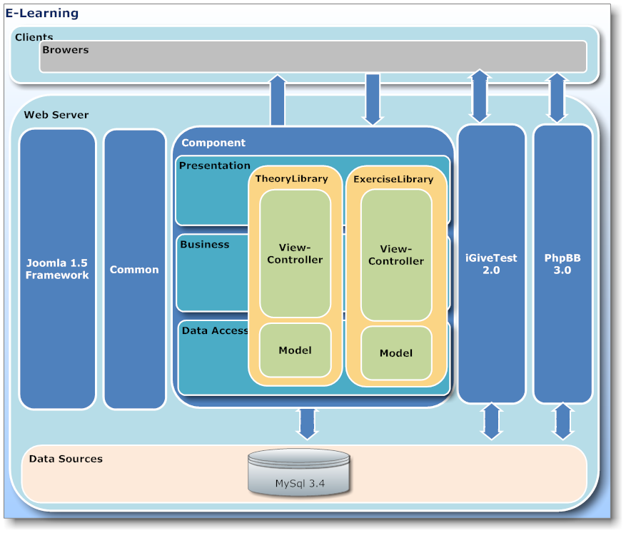
System Analysis and Design Architecture design

Slide 17
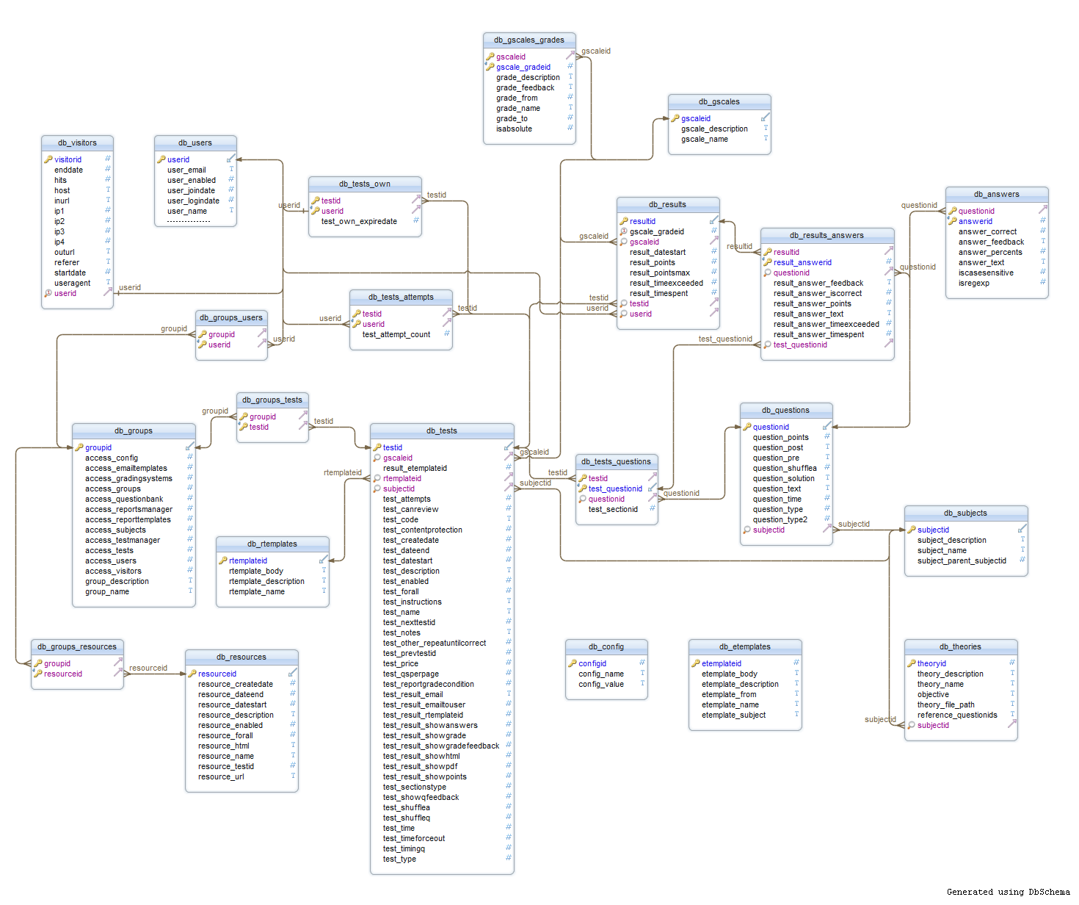
System Analysis and Design Database Structure

Slide 18
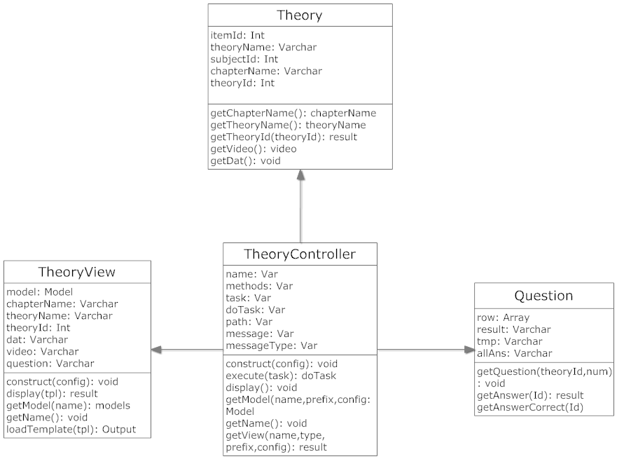
System Analysis and Design Class diagram

Slide 19
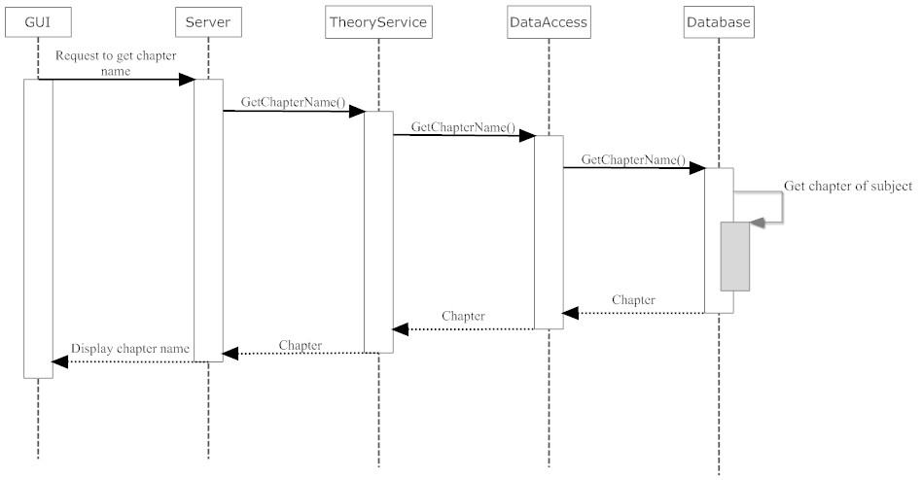
System Analysis and Design Sequence diagram

Slide 20
Test plan

Slide 21
Test report

Slide 22
summary

Slide 23
Q&A

Slide 24
Thank You

